Slide 1
Zotero Best Practices for LTER Sites
Tim Whiteaker
BLE-LTER
2019-02-11

Slide 2
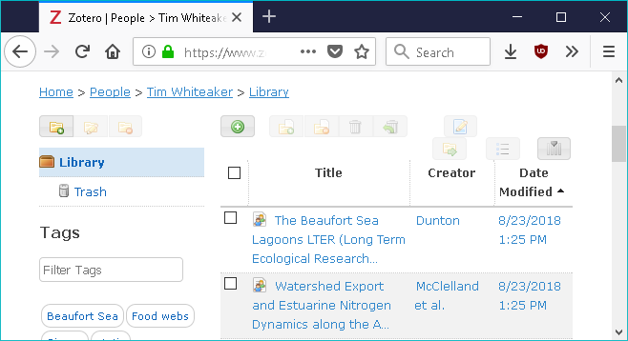
What Is Zotero
Free and open source reference manager
Like other reference managers, and:
Works locally and in the cloud
Has a online API
Notes:
You can use alternatives, or no reference manager at all

Slide 3
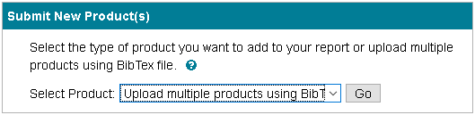
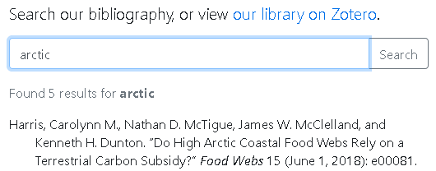
What I’ll Cover
Minimal Zotero introduction, plus:
simplifying Research.gov reporting,
and
a searchable bibliography for your website

Slide 4
Quick Start
Sign up for your free account at https://www.zotero.org/
Install desktop client and Firefox add-on (Zotero Connector)
Create LTER-ABC group

Slide 5
demo

Slide 6
Some Basic Suggestions
In the desktop client, set these preferences:
Don’t sync attachments
Don’t take webpage snapshots
Include a DOI when possible
Share privileges wisely
You get 300 MB at the free tier
Notes:
You can have attachments locally. Just don’t sync to cloud. I don’t see a need for webpage snapshots, unless the webpage itself is what you’re citing.
DOIs help identify duplicates

Slide 7
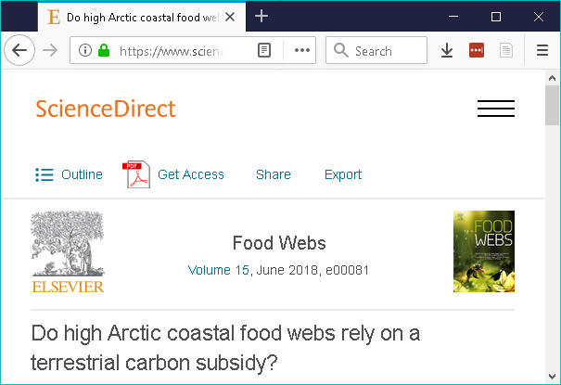
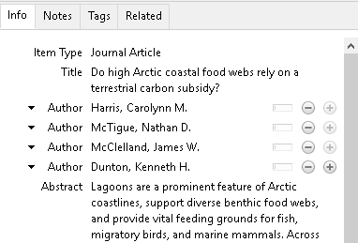
Use Zotero Connector on the Journal Site
Save to Zotero

Slide 8
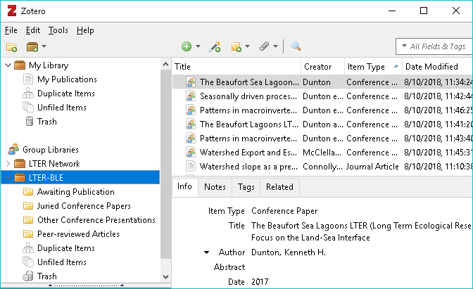
Organization
Your Library
Library Items
Your Groups
Collections
Create collections
to suit your needs
Notes:
Deleting an item from a collection doesn’t delete it from your library

Slide 9
Reporting to Research.gov

Slide 10
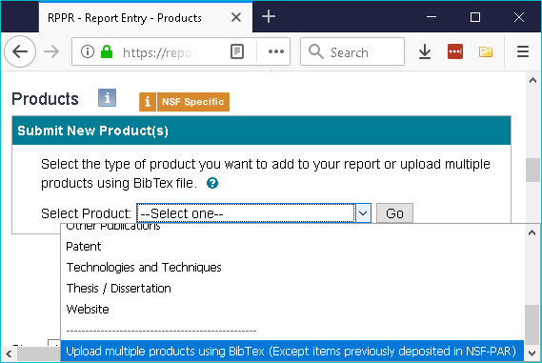
Research.gov Accepts BibTeX
Export from Zotero to BibTeX to upload products in bulk
Yay!

Slide 11
Crosswalk to Gov
For items awaiting publication, leave the year blank
Use the right fields, e.g., for non-peer-reviewed presentations:
The Zotero item type is Conference Paper
Enter the conference name as the Proceedings Title
See the Zotero Best Practices document for a more complete crosswalk
environmentaldatainitiative.org/resources/external-dm-resources/

Slide 12
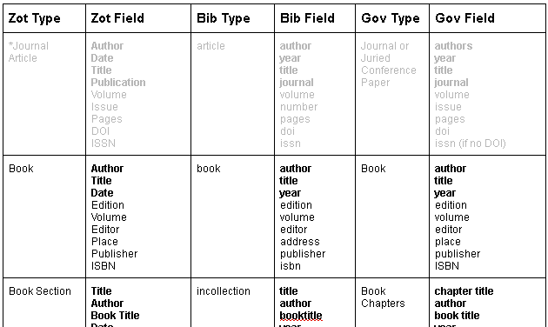
Crosswalk Table Preview

Slide 13
What Works
Yes
No (?)
Book
Book section
Thesis or dissertation
Conference paper or presentation
Peer-reviewed journal article
Item types not listed on this slide

Slide 14
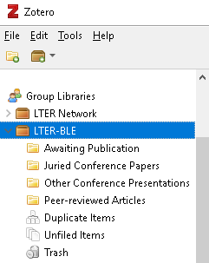
Organize with Collections
Peer-reviewed
Non-peer-reviewed
Awaiting publication
or whatever works for you

Slide 15
Research.gov Demo

Slide 16
Bibliography for Your Website

Slide 17
Zotero API Clients
ZotPress – WordPress plugin used by VCR and NGA
JavaScript Client – Designed for static websites; written and used by BLE https://github.com/BLE-LTER/Zotero-JavaScript-Search-Client
pyzotero – Python wrapper for the API; may be useful for Django sites

Slide 18
Should I Use It?
Pros
Cons
API usage is free, and it works
Existing clients available
Can handle tens of thousands of items
Slow
Advanced search is limited to filtering by item type

Slide 19
Summary
Zotero can expedite submission of non-peer reviewed products to Research.gov
Make sure you fill in the appropriate fields
API clients enable a searchable bibliography on your website
Use collections to your advantage

Slide 20
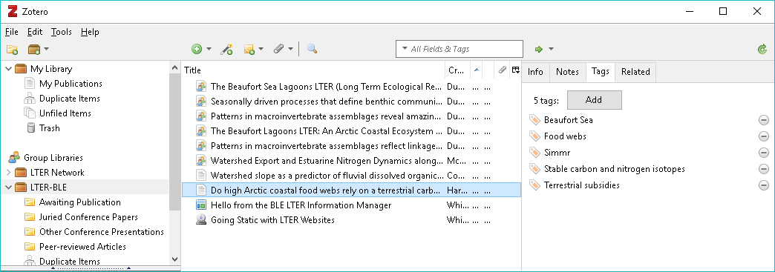
What about tags and notes?

Slide 21
For more info
See Zotero Best Practices in EDI’s external data management resources https://environmentaldatainitiative.org/resources/external-dm-resources/

